Slide 1
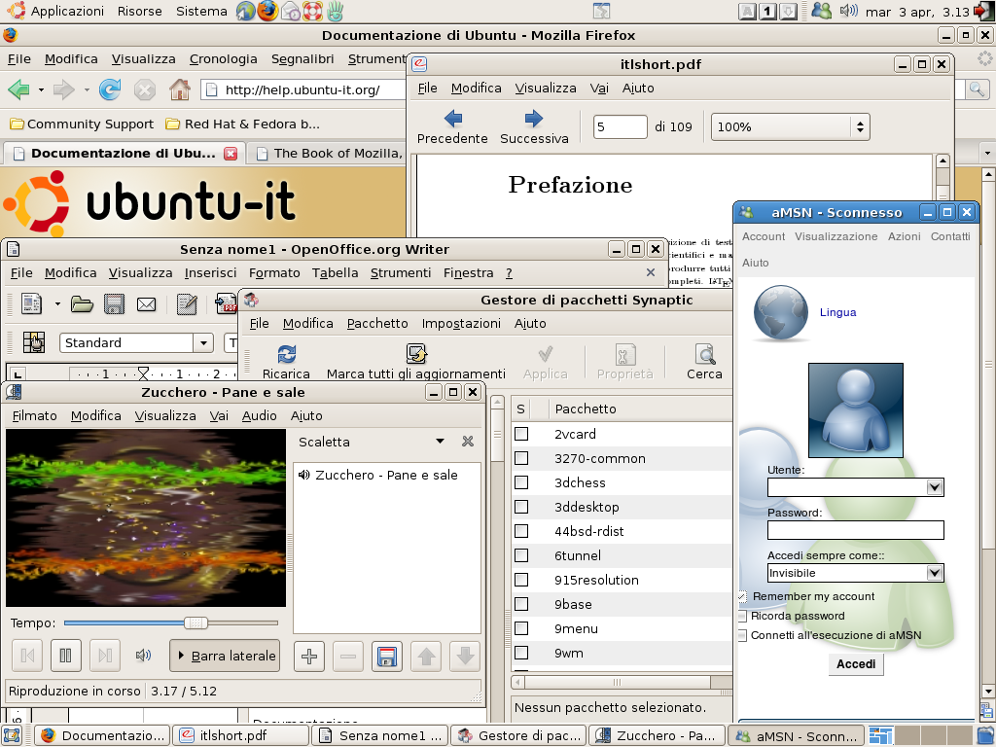
19: Internationalization
Notes:
Source: Wikipedia page
http://en.wikipedia.org/wiki/Internationalization_and_localization
http://en.wikipedia.org/wiki/File:Italian_localisation.png

Slide 2
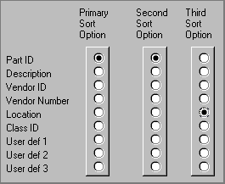
UI Hall of Fame or Shame?
Source: UI Hall of Shame
Notes:
Our Hall of Fame or Shame candidate for the day is this interface for choosing how a list of database records should be sorted. Let’s discuss its advantages and disadvantages, and contemplate alternative designs.
Like other sorting interfaces, this one allows the user to select more than one field to sort on, so that if two records are equal on the primary sort key, they are next compared by the secondary sort key, and so on.
On the plus side, this interface communicates one aspect of its model very well. Each column is a set of radio buttons, clearly grouped together (both by gestalt proximity and by an explicit raised border). Radio buttons have the property that only one can be selected at a time. So the interface has a clear affordance for picking only one field for each sort key.
But, on the down side, the radio buttons don’t afford making NO choice. What if I want to sort by only one key? I have to resort to a trick, like setting all three sort keys to the same field. The interface model clearly doesn’t map correctly to the task it’s intended to perform. In fact, unlike typical model mismatch problems, both the user and the system have to adjust to this silly interface model – the user by selecting the same field more than once, and the system by detecting redundant selections in order to avoid doing unnecessary sorts.
The interface also fails on minimalist design grounds. It wastes a huge amount of screen real estate on a two-dimensional matrix, which doesn’t convey enough information to merit the cost. The column labels are similarly redundant; “sort option” could be factored out to a higher level heading. The term “Primary” is not really consistent with “Second” and “Third”; “First” would be simpler.
Some other systems:
Excel
Itunes
http://tablesorter.com/docs/
Email?

Slide 3
UI Hall of Fame or Shame?

Slide 5
Nanoquiz
closed book, closed notes
3 minutes (timer in upper right)
if you can’t use the online form, use paper
close your laptop when you’re done

Slide 6
0:04
0:09
0:08
0:07
0:05
0:03
0:02
0:01
0:00
0:14
3:00
2:30
2:00
1:45
1:30
1:15
1:00
0:45
0:30
0:20
0:19
0:18
0:17
0:16
0:15
0:13
0:12
0:11
0:10
0:06
Which of the following are correct about internationalization? (choose all that apply) A. Unicode strings cannot mix characters from multiple scripts. B. Script direction can affect screen layout. C. A message file combines localizable messages with source code.
Which of the following lines of HTML/Javascript/CSS are likely to have to change during internationalization and localization? (choose all that apply) A. margin-left: 30px; /* within a div containing text */ B. var startingBalance = 0.00; C. $(“#date”).text(“04/10/2015"); D. if (amount > 1) label += "s"; E. <button><img src=“cancel.png” alt=“cancel”></button> F. alert("FileNotFoundException"); G. function stringCompare(a, b) { return ((a < b) ? -1 : ((a > b) ? 1 : 0)); }
Notes:
. Legibility refers to the effectiveness of the whole reading process.

Slide 7
Learning Objectives
Discuss various factors to take into account in internationalization and localization.
Practice internationalization and localization of a webpage.
Explore, synthesize, and compare websites in different cultures.
Notes:
Culture
Symbols
Color
Left->Right
Formatting of numbers and symbols
Photos

Slide 8
What to consider in internationalization?

Slide 9
What to consider in internationalization?
Language / Script
Direction
Character system
Formatting of number, date, currency
Symbols / Icons
Color
Culture
Policy

Slide 10
Translation is hard.

Slide 11
Activity: Localize a grocery list
Use Javascript libraries for i18n
Work in pairs to:
format instructions
format the grocery list
format prices and dates
shoutkey.com/cursor
Notes:
http://courses.csail.mit.edu/6.831/2015/inclass/19-internationalization/activities/ac19-i18n/ac19-i18n.shtml

Slide 12
Activity: Localize a grocery list
$("#title") .html(t("title"));
$("#instructions") .html(t("instructions", {store: "Whole Foods"}));
$("#list").append("<li>"+t("items.apple", {count:5})+"</li>"); $("#list").append("<li>"+t("items.milk", {count:1})+"</li>"); $("#list").append("<li>"+t("items.icecream", {count:2})+"</li>");
$("#list").append("<li>"+t("items.steak", {count:2})+"</li>");
$("#date") .html("<b>Date: </b>" + moment().format("L"));
$("#price") .html("<b>Price: </b>" + numeral(1022.23) .format("$0,0.00"));

Slide 13
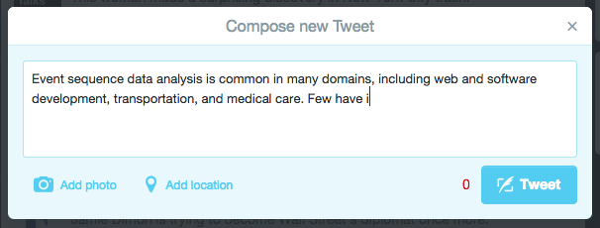
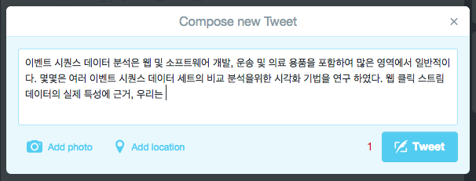
People’s System Usage Is Affected
Event sequence data analysis is common in many domains, including web and software development, transportation, and medical care. Few have investigated visualization techniques for comparative analysis of multiple event sequence datasets. Grounded in the real-world characteristics of web clickstream data, we
Notes:
Event sequence data analysis is common in many domains, including web and software development, transportation, and medical care. Few have investigated visualization techniques for comparative analysis of multiple event sequence datasets. Grounded in the real-world characteristics of web clickstream data, we explore visualization techniques for comparison of two clickstream datasets collected on different days or from users with different demographics. Through iterative design with web analysts, we designed MatrixWave, a matrix-based representation that allows analysts to get an overview of differences in traffic patterns and interactively explore paths through the website. We use color to encode differences and size to offer context over traffic volume. User feedback on MatrixWave is positive. Our study participants made fewer errors with MatrixWave and preferred it over the more familiar Sankey diagram.

Slide 14
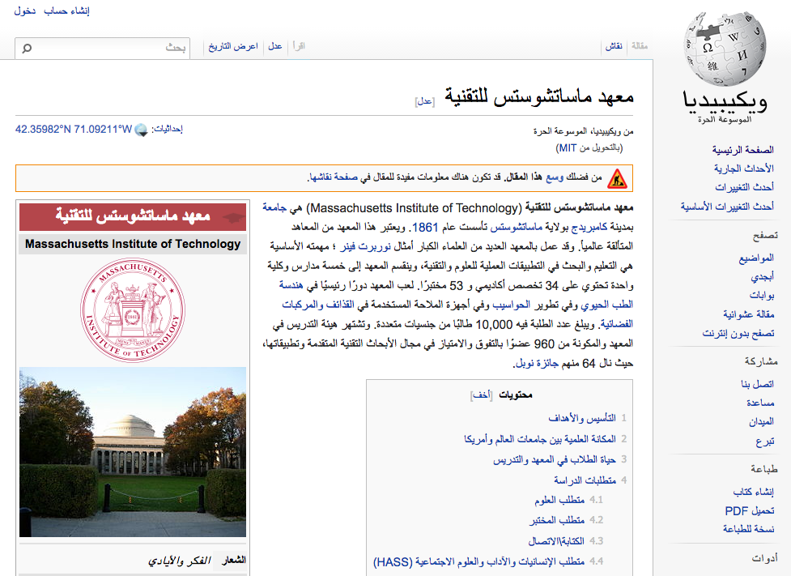
People’s System Usage Is Affected
Try browsing, selecting text, dragging a page in Arabic.
shoutkey.com/gnat

Slide 15
Other Things to Consider
Age / ID verification
Mobile verification
Banned services
Finance: credit card, payment

Slide 16
Browser Usage

Slide 17
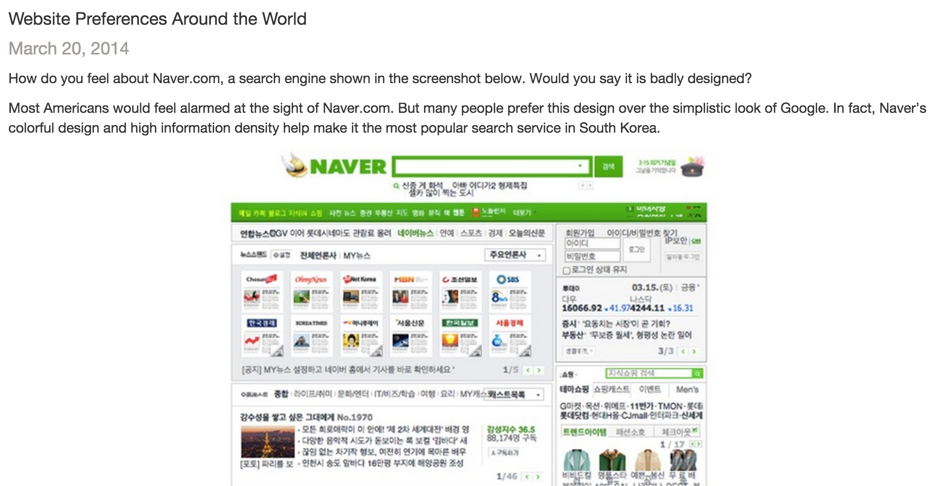
Website Preferences Around the World
Let’s check out the blog post: shoutkey.com/humor
Notes:
Go over the blog post associated with this paper:
http://labinthewild.org/blog.php
Quantifying Visual Preferences Around the World
Reinecke and Gajos, CHI 2014

Slide 18
Hofstede’s Cultural Dimensions Theory
Power Distance
belief that power is distributed unequally
Individualism vs Collectivism
Individuals are integrated into groups?
Masculinity vs Femininity
distribution of emotional roles between the genders
Uncertainty Avoidance
tolerance for uncertainty and ambiguity

Slide 19
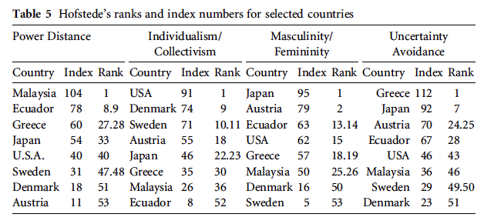
Hofstede’s Cultural Dimensions Theory

Slide 20
Activity Part 1. Explore
Compare how website design aesthetics differ around the world!
For your country, find an example university homepage.
Analyze it and fill out the form.
Do it by yourself.
shoutkey.com/southern
Notes:
http://courses.csail.mit.edu/6.831/2015/inclass/19-internationalization/activities/cc-explore.html

Slide 21
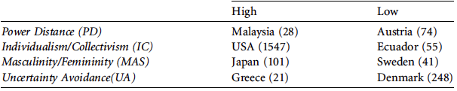
Activity Part 2. Synthesize
Check out classmates’ responses.
What trends do you see for your country?
(use the tabs at the bottom to select)
Relate to Hofstede’s Cultural Dimensions Theory
shoutkey.com/valid
Notes:
Responses:
https://docs.google.com/spreadsheets/d/10-sHXgMcnfuTSbPKSG1vgqV5dI05CAxE_ljc8KlwzNM/edit?usp=sharing

Slide 22
Activity Part 3. Compare
Turn to a neighbor w/ a different country.
Discuss the designs in the two countries you were assigned.
In what ways are the designs similar?
In what way are they different?
shoutkey.com/handshake
Notes:
http://courses.csail.mit.edu/6.831/2015/inclass/19-internationalization/activities/cc-synthesize.html

Slide 23
Rule of Thumb in Design for i18n
Don’t assume WEIRD
Western
Educated
Industrialized
Rich
Democratic
Notes:
Go over the blog post associated with this paper:
http://labinthewild.org/blog.php
Quantifying Visual Preferences Around the World
Reinecke and Gajos, CHI 2014

Slide 24
0:04
0:09
0:08
0:07
0:05
0:03
0:02
0:01
0:00
0:14
3:00
2:30
2:00
1:45
1:30
1:15
1:00
0:45
0:30
0:20
0:19
0:18
0:17
0:16
0:15
0:13
0:12
0:11
0:10
0:06
Which of the following are correct about internationalization? (choose all that apply) A. Unicode strings cannot mix characters from multiple scripts. B. Script direction can affect screen layout. C. A message file combines localizable messages with source code.
Which of the following lines of HTML/Javascript/CSS are likely to have to change during internationalization and localization? (choose all that apply) A. margin-left: 30px; /* within a div containing text */ B. var startingBalance = 0.00; C. $(“#date”).text(“04/10/2015"); D. if (amount > 1) label += "s"; E. <button><img src=“cancel.png” alt=“cancel”></button> F. alert("FileNotFoundException"); G. function stringCompare(a, b) { return ((a < b) ? -1 : ((a > b) ? 1 : 0)); }

Slide 25
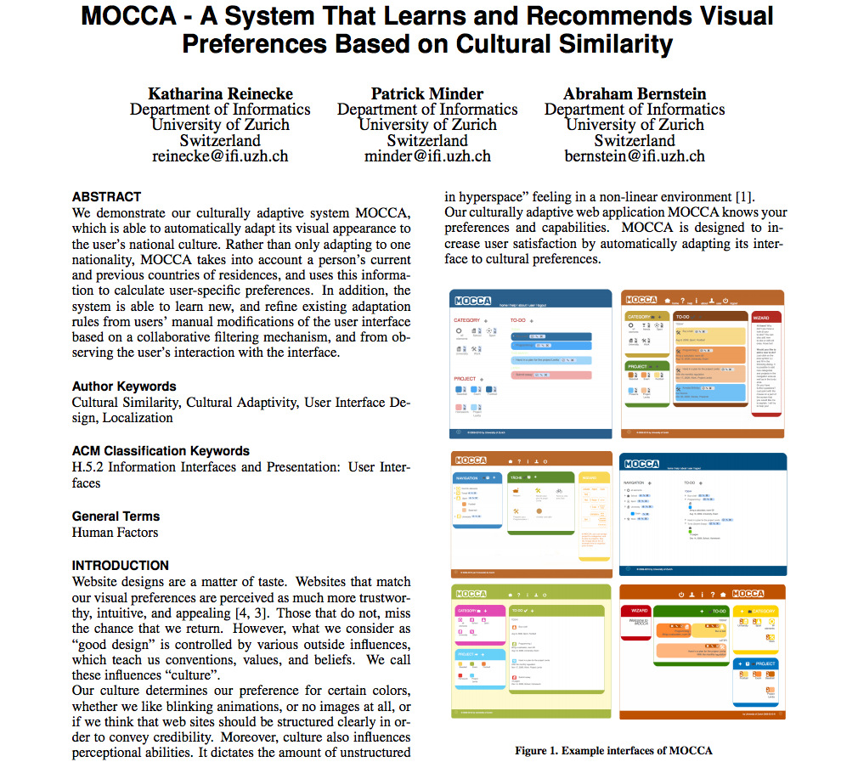
Paper: Culturally Adaptive User Interface
Notes:
http://reinecke.people.si.umich.edu/Publications_files/de226o-reinecke.pdf

